Slide 1
3D Object Volume Calculation Using C++
Ollengo, Newton Kelvin

Slide 2
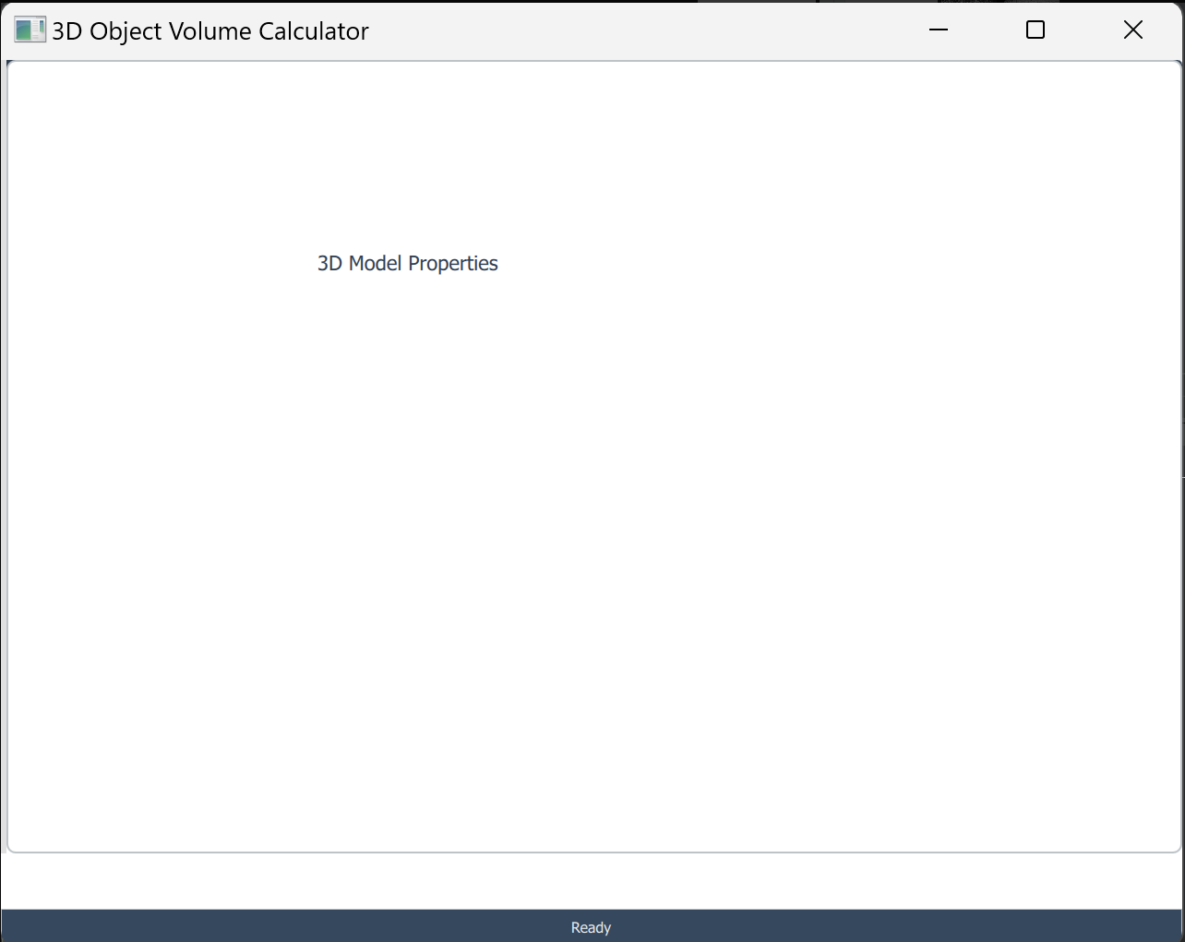
01
Goal: Reconstruct 3D object volume from 2D slices using C++ and VTK.
02
Input: A series of 2D slices (e.g., CT scans).
Project Overview
03
Pre-processing: Thresholding and smoothing applied to enhance data.
04
Volume Rendering: Combine slices to generate a 3D model.
05
Volume Calculation: Compute the object volume based on voxel data.

Slide 3
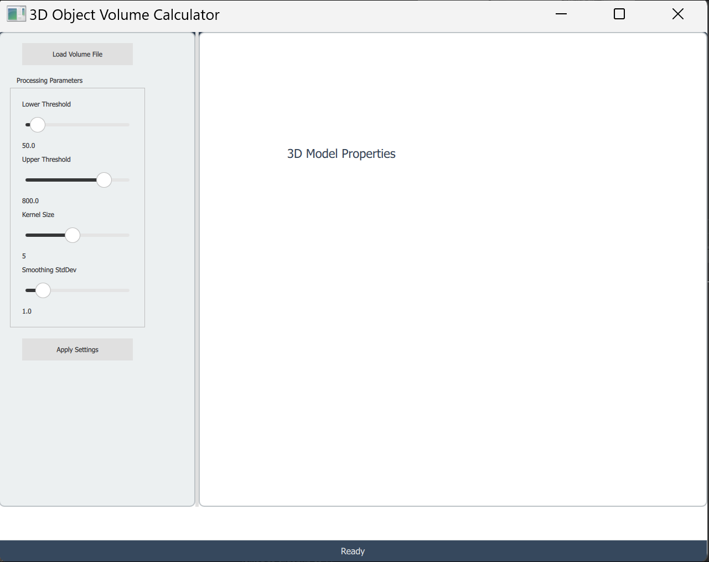
Tools and Libraries
VTK (Visualization Toolkit)
A powerful open-source library for 3D graphics, image processing, and visualization. VTK is ideal for rendering volumetric data and reconstructing 3D models.
CMake
CMake simplifies the build process by managing compilation and linking of C++ projects, ensuring smooth integration with external libraries like VTK.
Programming Language: C++
C++ was chosen for its performance and ability to efficiently handle large datasets required in 3D reconstruction tasks.

Slide 4
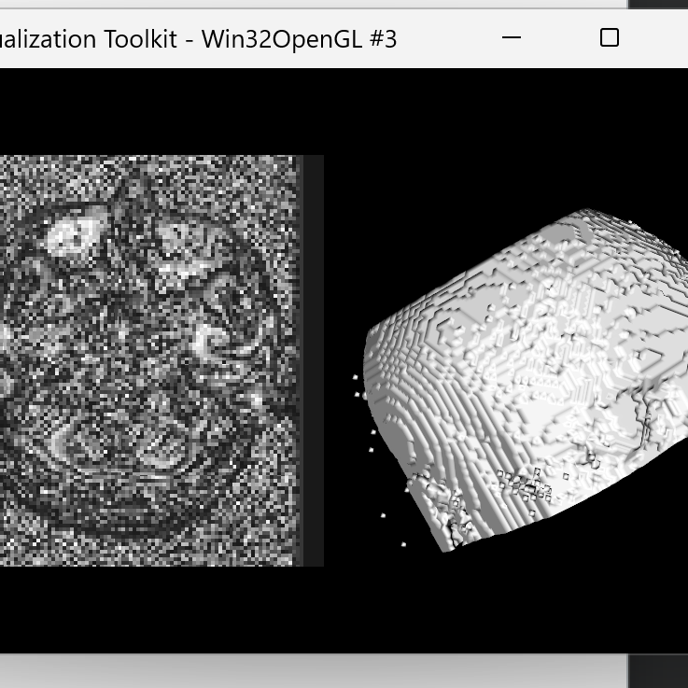
Why Use Volume Rendering?
Applications of the Project
Volume rendering techniques allow visualization of internal structures, which is essential in medical imaging, 3D printing, and non-destructive testing.
- Medical Imaging: Accurate CT/MRI reconstruction.
- 3D Printing: High precision model creation.
- Engineering: Analyze internal defects of materials.

Slide 5


Slide 6
How is Multithreading Applied?
Error Handling and Callbacks
Multithreading using std::thread allows the main application to stay responsive while data loading and rendering happen in the background. Mutex synchronization ensures thread safety when rendering.
The use of C++ exceptions ensures that any failure in file handling or rendering (e.g., invalid formats) is caught and handled gracefully. VTK callbacks help manage rendering events efficiently.

Slide 7
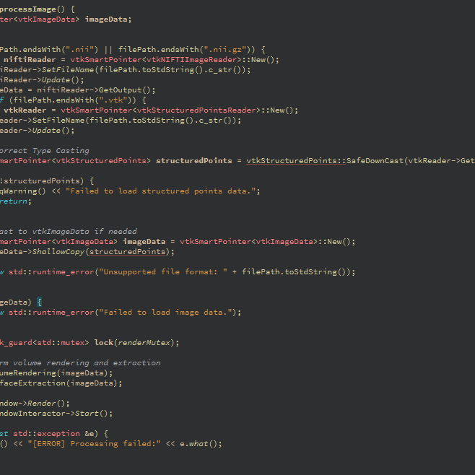
Advanced C++ Programming Techniques
Multithreading with std::thread and Mutex
The application processes large datasets asynchronously using std::thread for file loading and std::mutex for thread synchronization, ensuring smooth performance.
Error Handling with Exceptions
Robust error handling is achieved through C++ exceptions, allowing graceful error recovery when unsupported file formats or failed data loads occur.
Integration with Qt and VTK
Combining Qt for the user interface and VTK for 3D rendering showcases modular design, utilizing QML to expose C++ classes for seamless interaction.

Slide 8
Project Impact and Future Applications
What are the key outcomes of this project?
Conclusion
This project successfully demonstrates the use of C++ and VTK to reconstruct a 3D model from 2D slices and accurately compute its volume. The application has broad implications in medical imaging, 3D printing, and industrial analysis, providing a foundation for future enhancements and integration of advanced techniques.

